Slide 1
Introduction to Neo4j Graph Database
<your name and details>

Slide 2
In this session
We will cover:
What is a graph and why we want them
Spotting good graph scenarios
Property graph database anatomy
Continuing your graph journey

Slide 3
What is a graph?

Slide 4
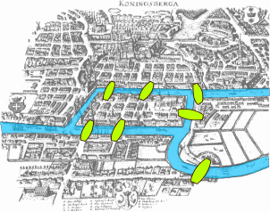
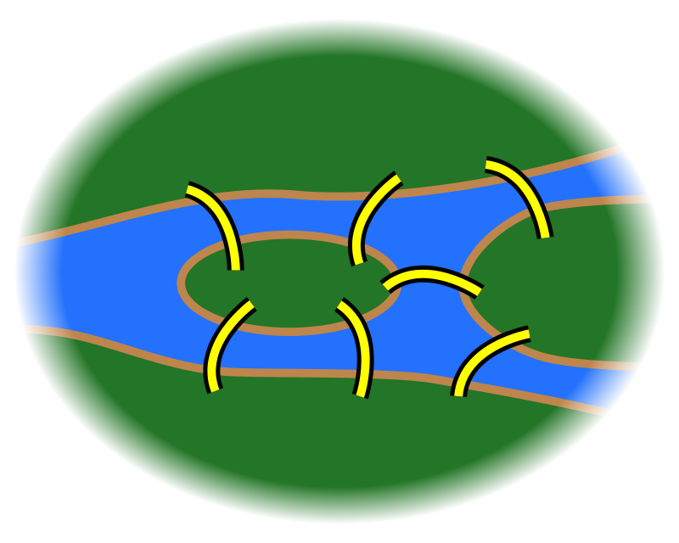
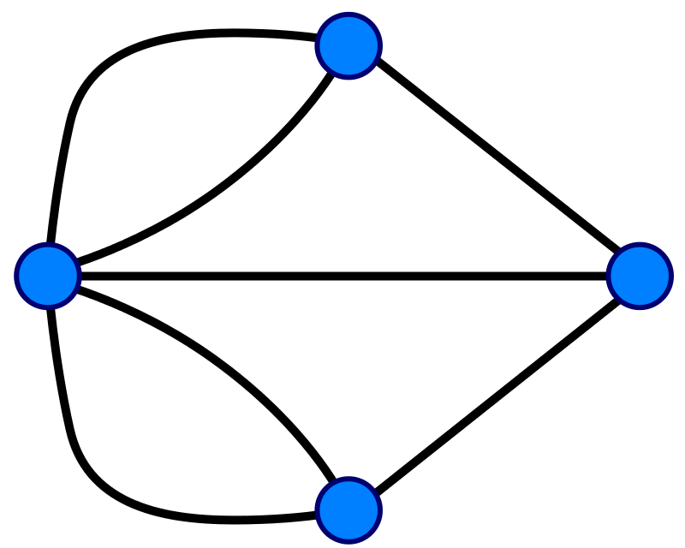
A graph is...
...a set of discrete objects, each of which has some set of relationships with the other objects
Seven Bridges of Konigsberg problem. Leonhard Euler, 1735

Slide 5
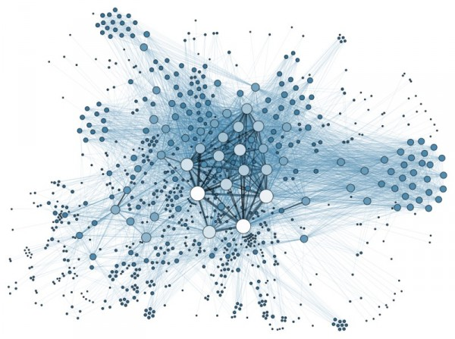
Anything can be a graph
the Internet
a water molecule
H
H
O

Slide 6
Why do we want graphs?

Slide 7


Slide 8
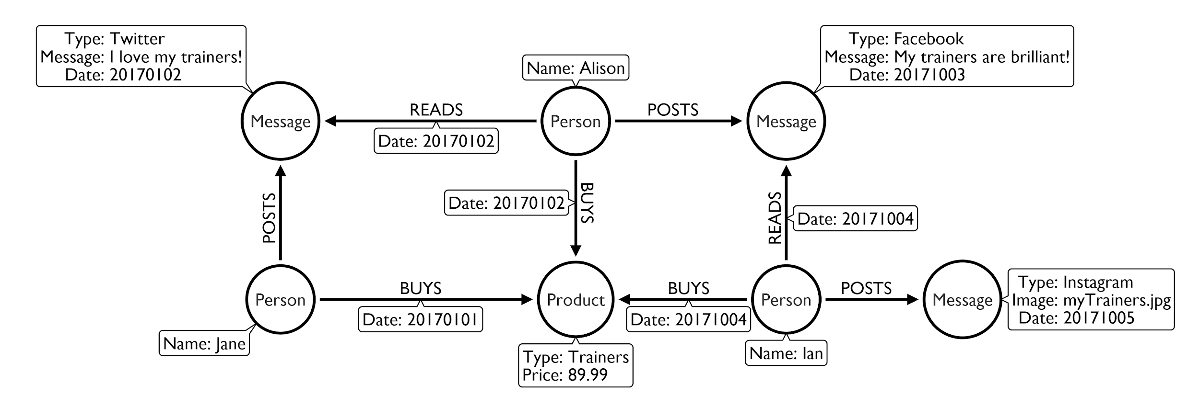
Follow the flow - buying trainers

Slide 9
Panama papers:
simple model, powerful outcome

Slide 10
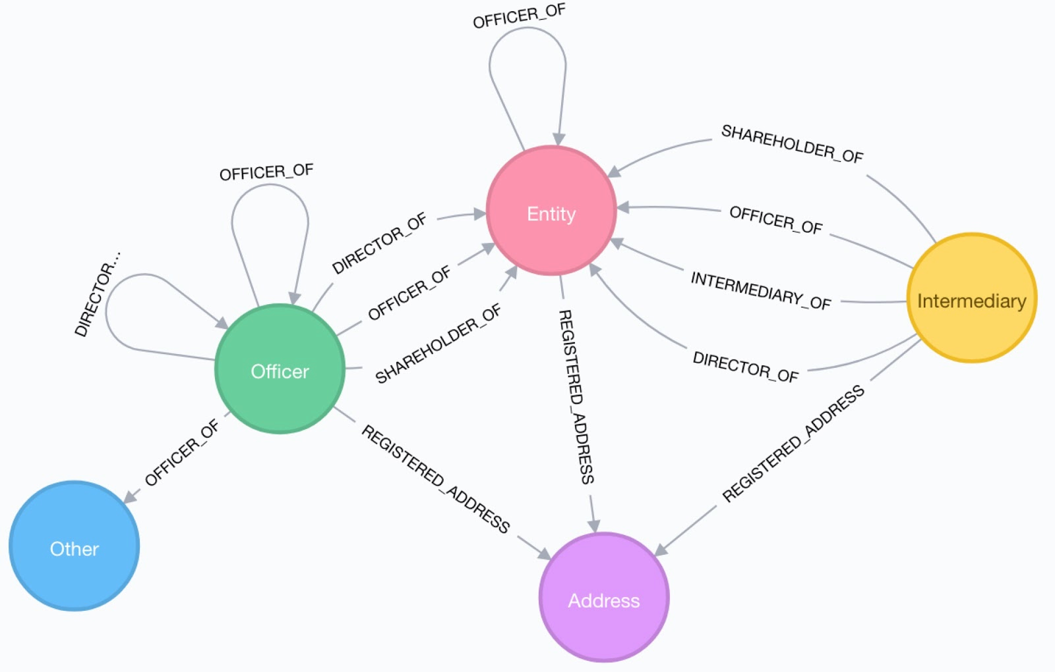
The Panama papers data model...

Slide 11
Roses are red,
facebook is blue,
No mutual friends,
So who are you?

Slide 12
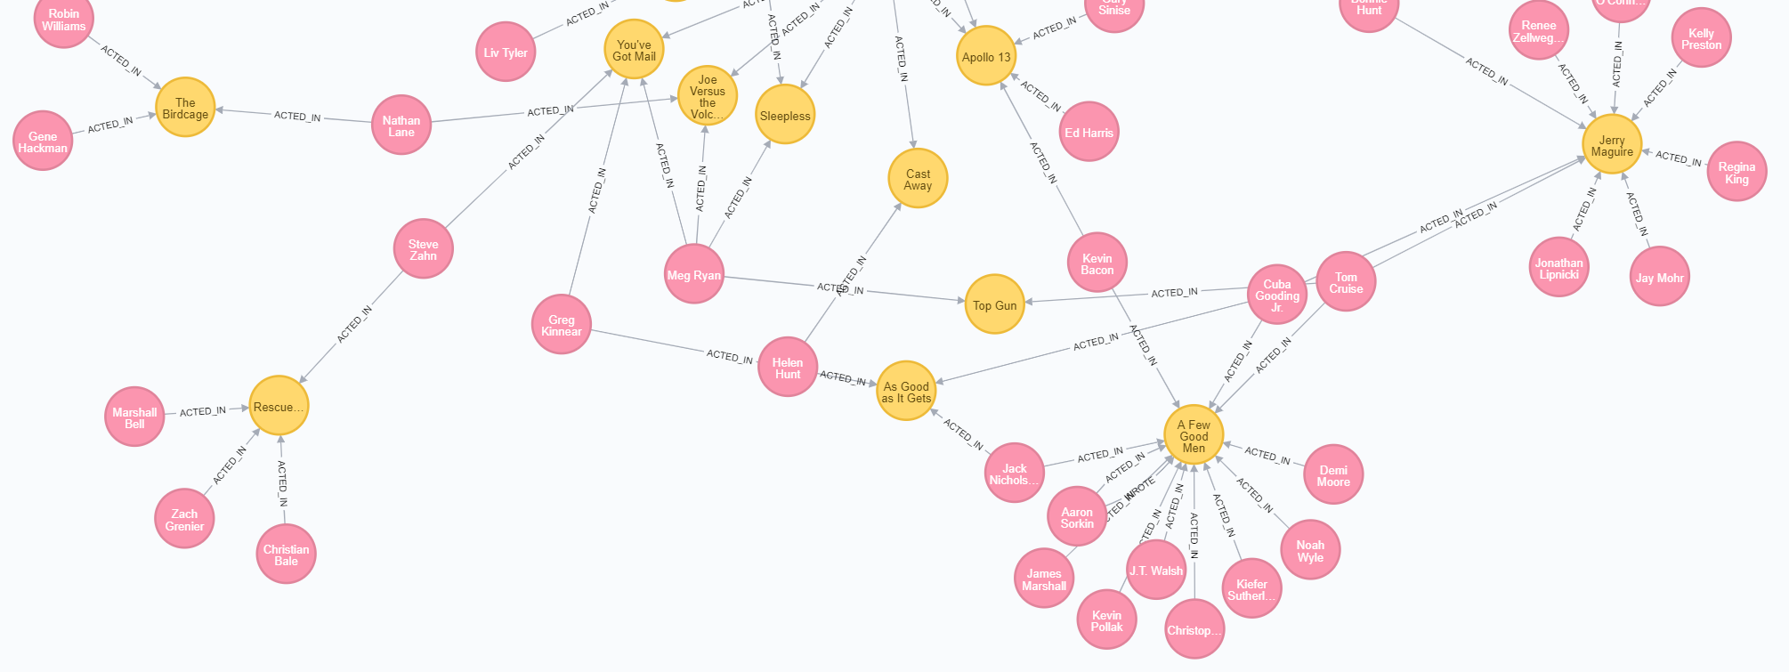
Friends of friends
...or co-actors of co-actors

Slide 13
What are good graph scenarios?

Slide 14
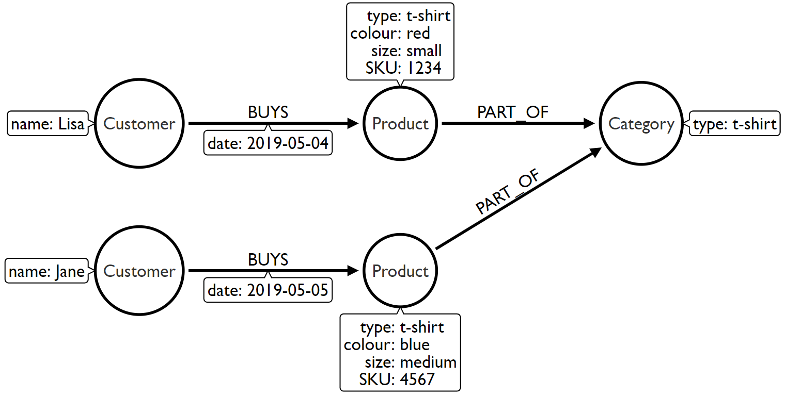
Identifying good graph scenarios
Scenario 1: Does our problem involve understanding relationships between entities?
Recommendations
Fraud detection
Finding duplicates
Data lineage

Slide 15
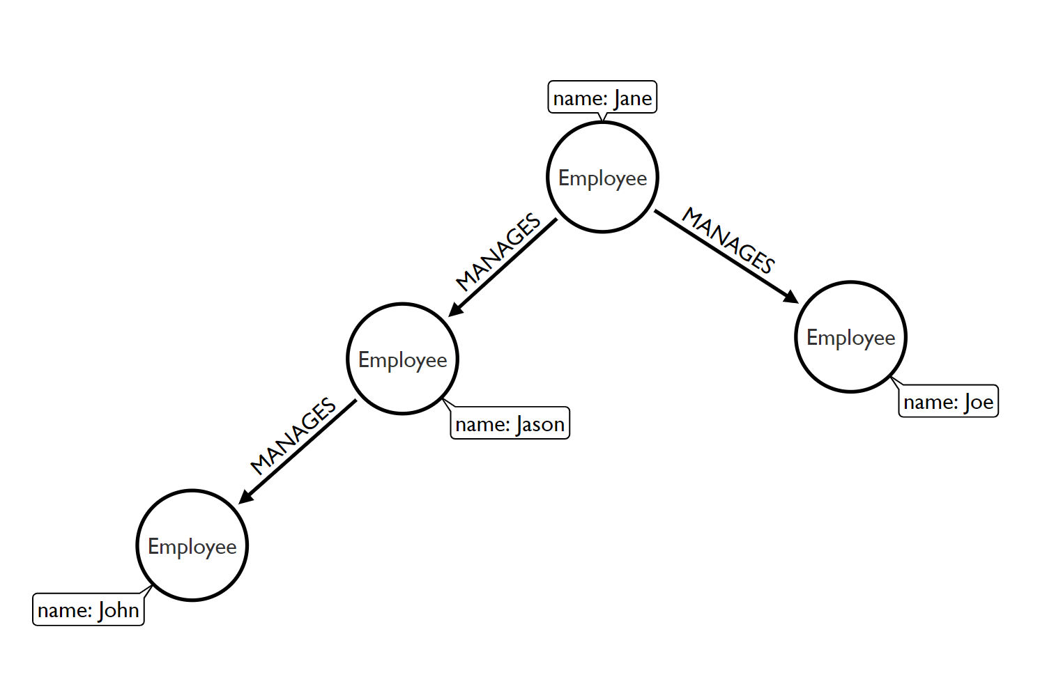
Identifying good graph scenarios
Scenario 2: Does the problem involve a lot of self-referencing to the same type of entity?
Organisational hierarchies
Access management
Social influencers
Friends of friends

Slide 16
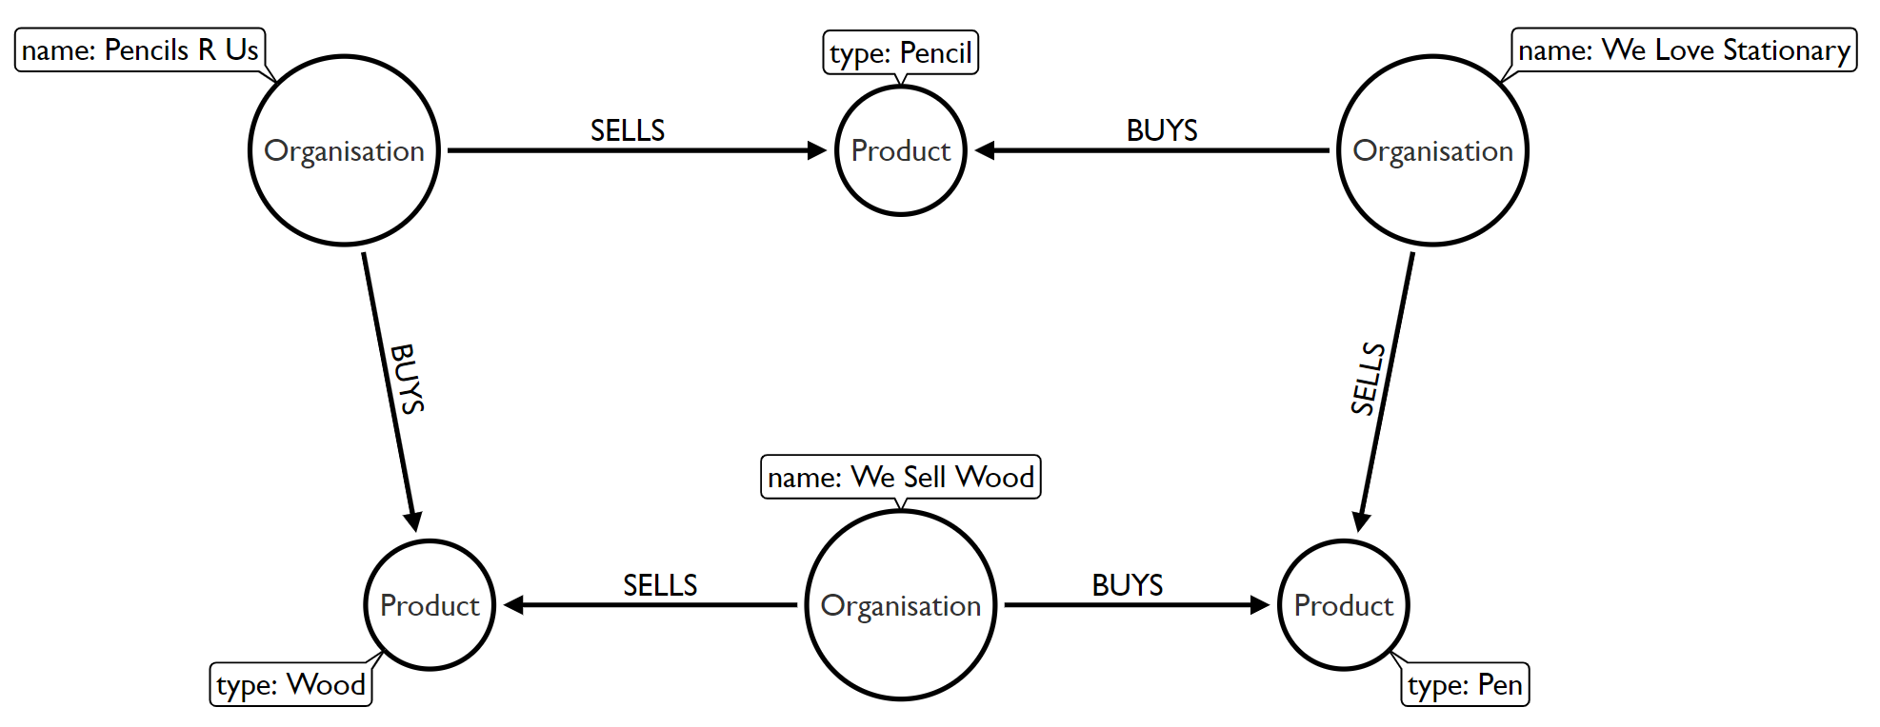
Identifying good graph scenarios
Scenario 3: Does the problem explore relationships of varying or unknown depth?
Supply chain visibility
Bill of Materials
Network management

Slide 17
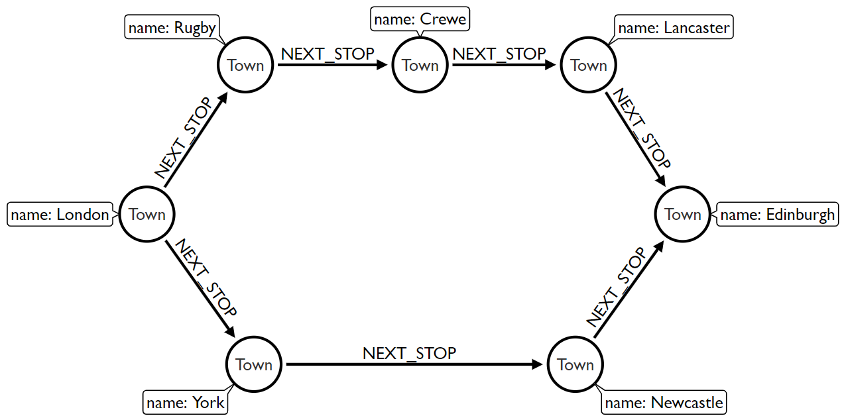
Identifying good graph scenarios
Scenario 4: Does our problem involve discovering lots of different routes or paths?
Logistics and routing
Infrastructure management
Dependency tracing

Slide 18
So what does a (property) graph look like?

Slide 19
Graph components
Node (Vertex)
The main data element from which graphs are constructed
Jane
car

Slide 20
Graph components
Node (Vertex)
The main data element from which graphs are constructed
Relationship (Edge)
A link between two nodes. Has:
Direction
Type
A node without relationships is permitted. A relationship without nodes is not
Jane
car
OWNS

Slide 21
Property graph database
Node (Vertex)
Relationship (Edge)
OWNS

Slide 22
Property graph database
Node (Vertex)
Relationship (Edge)
Label
Define node category (optional)
:Person
:Car
OWNS

Slide 23
Property graph database
Node (Vertex)
Relationship (Edge)
Label
Define node category (optional)
Can have more than one
:Person
:Car
:Asset
OWNS

Slide 24
Property graph database
Node (Vertex)
Relationship (Edge)
Label
Define node category (optional)
Can have more than one
:Person
:Car
:Asset
OWNS
since: 2018
Properties
Enrich a node or relationship
No need for nulls!
name: Jane
make: Volvo
model: V60

Slide 25
How do I query the graph?

Slide 26
Cypher
A pattern-matching query language made for graphs
‹#›￼

Slide 27
Cypher
A pattern matching query language made for graphs
Declarative
Expressive
Pattern-Matching
‹#›￼

Slide 28
Cypher
A pattern matching query language made for graphs
Declarative
Expressive
Pattern Matching
With ASCII ART ¯\_(ツ)_/¯
‹#›￼

Slide 29
So where can I find out more?

Slide 30
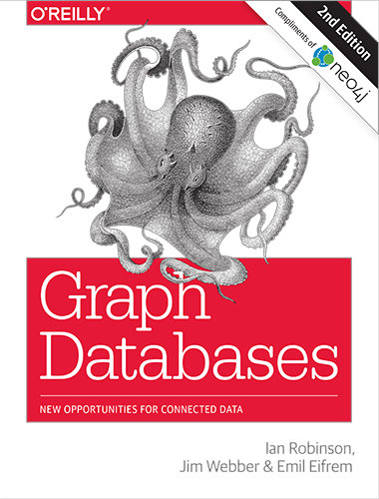
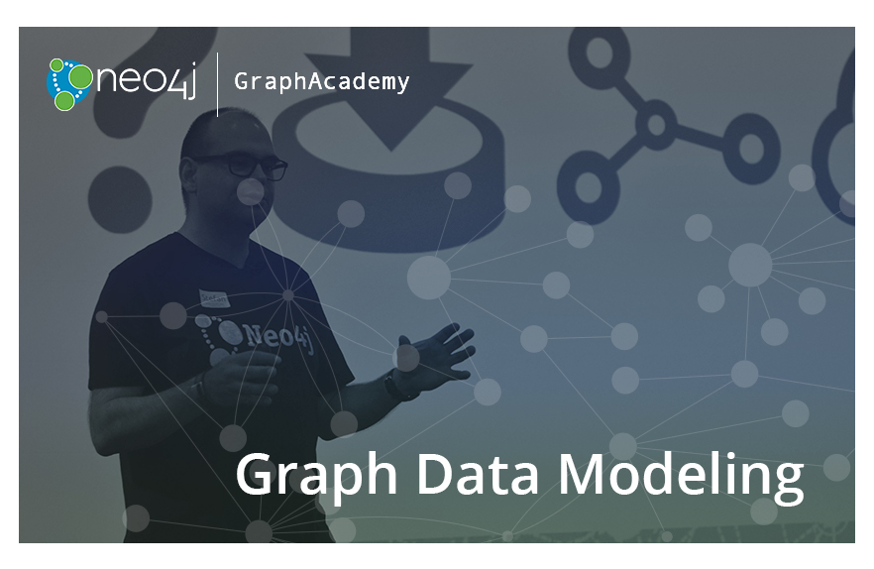
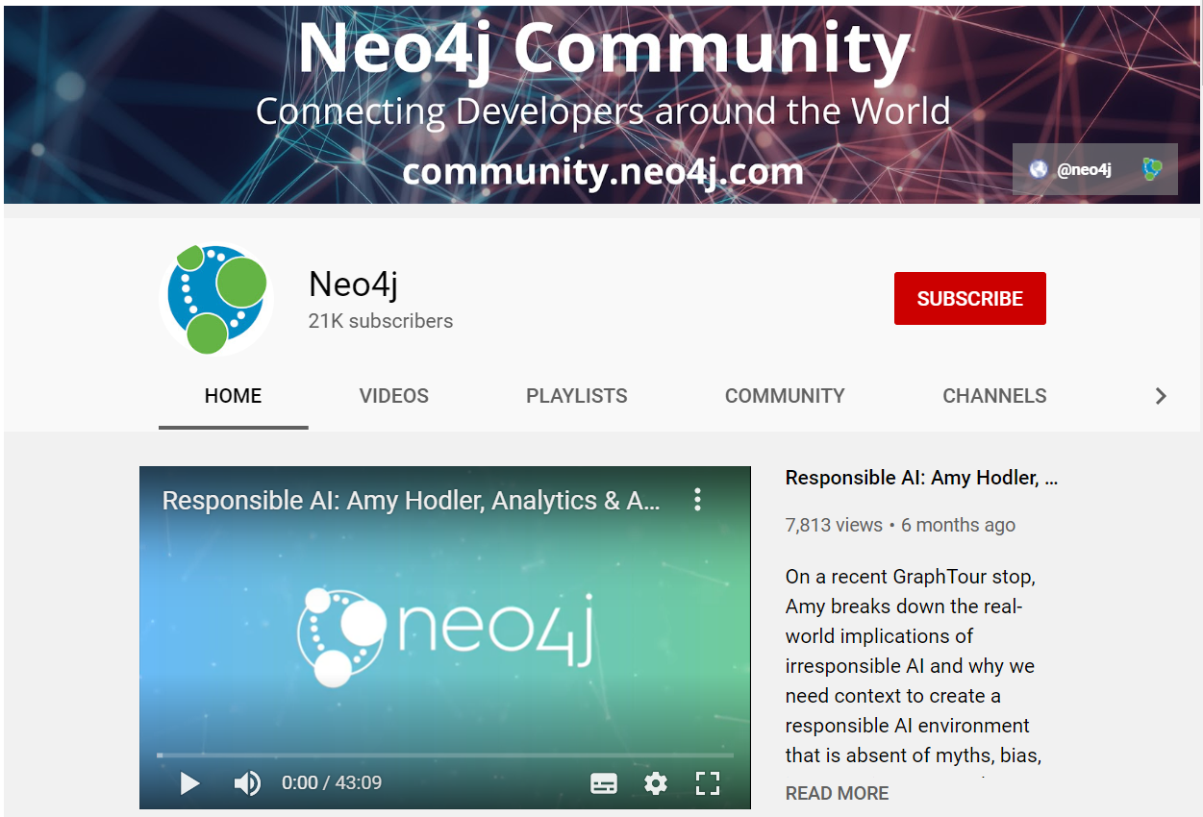
Free book:
neo4j.com/graph-databases-book
Free online training and certification:
neo4j.com/graphacademy/online-training
How to, best practices and user stories:
youtube.com/neo4j

